Slide 1

Chris Woodruff
LearningAbout.Dev
Level: Intermediate, etc.

Slide 2

Developing the API Endpoints
Learn to Produce Effective Web APIs with ASP.NET 5

Slide 3
Dependency Injection

Slide 4
Dependency Injection
services.AddScoped<IChinookSupervisor, ChinookSupervisor>();
Services can be registered with one of the following lifetimes:
Lifetime | Details
Transient | Transient lifetime services are created each time they're requested from the service container.
Scoped | Scoped lifetime indicates that services are created once per client request (connection).
Singleton | The first time the service requested. Every subsequent request of the service implementation from the dependency injection container uses the same instance.

Slide 5
CORS
2 Ways to set up CORS in your Web API
Annotations in your Controllers or Actions
or
Set up a Policy in Startup and assign in Configure().

Slide 6
CORS
[Route("api/[controller]")]
[ApiController]
public class WidgetController : ControllerBase
{
// GET api/values
[EnableCors(" CorsPolicy ")]
[HttpGet]
public ActionResult<IEnumerable<string>> Get()
{
return new string[] { "green widget", "red widget" };
}

Slide 7
CORS
services.AddCors(options =>
{
options.AddPolicy("CorsPolicy",
builder => builder.AllowAnyOrigin()
.AllowAnyMethod()
.AllowAnyHeader());
});

Slide 8
CORS
GET http://myserver.chinookmusicstore.net/api/test HTTP/1.1
Referer: http://myclient. chinookmusicstore.net/
Accept: */*
Accept-Language: en-US
Origin: http://myclient. chinookmusicstore.net
Accept-Encoding: gzip, deflate
User-Agent: Mozilla/5.0 (compatible; MSIE 10.0; Windows NT 6.2; WOW64; Trident/6.0)
Host: myservice. chinookmusicstore.net

Slide 9
CORS
HTTP/1.1 200 OK
Cache-Control: no-cache
Pragma: no-cache
Content-Type: text/plain; charset=utf-8
Access-Control-Allow-Origin: http://myclient. chinookmusicstore.net
Date: Wed, 05 Jun 2013 06:27:30 GMT
Content-Length: 17

Slide 10
CORS

Slide 11
CORS Preflight
OPTIONS https://localhost/api/Albums/1 HTTP/1.1
Host: localhost
Access-Control-Request-Method: PUT
Origin: https://localhost:55912 Access-Control-Request-Headers: content-type
Accept: */*
HTTP/1.1 200 OK Access-Control-Allow-Origin: https://localhost:55912
Access-Control-Allow-Methods: PUT
Access-Control-Allow-Headers: content-typeAccess-Control-Max-Age: 600

Slide 12
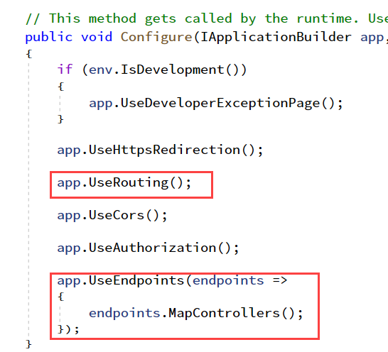
Controllers and Actions : Routing

Slide 13
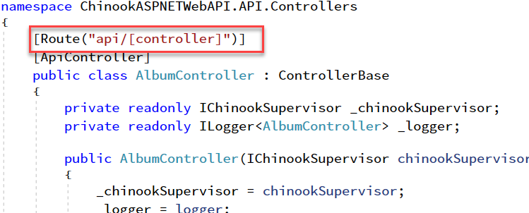
Controllers and Actions : Routing

Slide 14
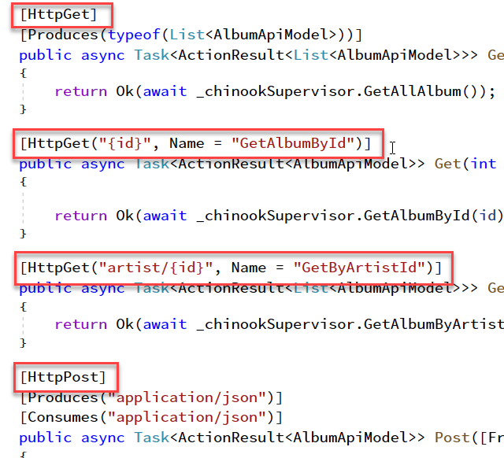
Controllers and Actions: HTTP Verbs

Slide 15
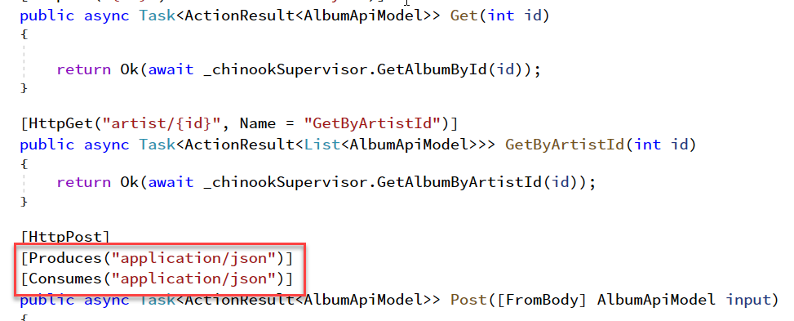
Controllers and Actions: Producing and Consuming

